Slide 1
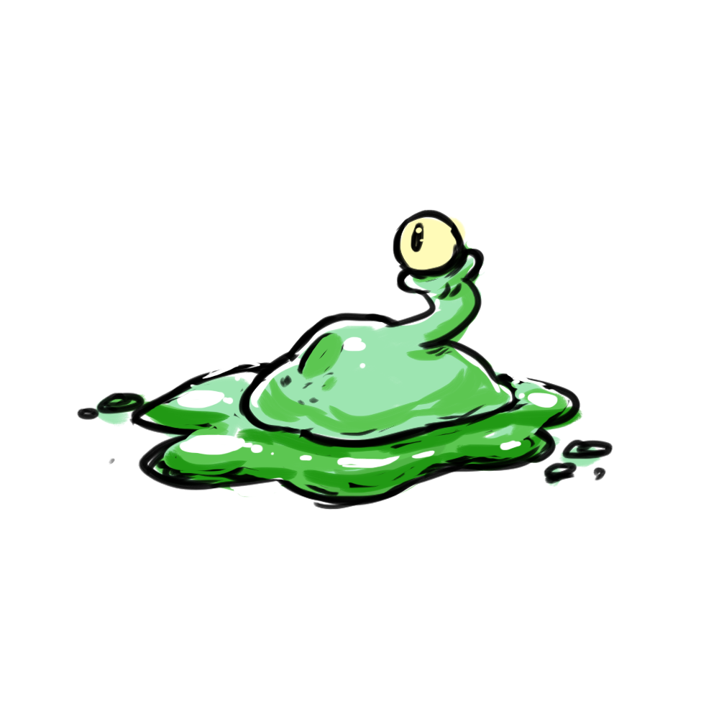
Clean-em-Up!
CMPS-115 Summer 2018
7/27/2018
Team Ｓ Ｌ Ｉ Ｍ Ｅ Ｂ Ｏ Ｙ Ｓ
Team Members:
Stephen, Riley, Dmitry, Ben, Marlo, Brendan

Slide 2
Clean-em-Up!
Motivation
Goals we set to achieve:
We wanted a game that we would want to play with friends.
Game play should be fun for all players
Learn agile Scrum process
We wanted to learn how to make games in the Unity engine
Notes:
We sought to make an asymmetrical style of game where there would be a team of 3 slimes playing against a team of 1 janitor. We were able to achieve this and add several other game modes; 1 vs.1, 2 vs. 1, etc.

Slide 3
Clean-em-Up!
Goals
Set Out to Achieve
A working game that is fun to play with friends.
Complete functionality (Menus, supporting different number of player).
Visuals (sprites, textures, etc.).
A relatively polished product, minimal bugs or missing features.
Have Achieved
A fun playable game
Working menus and varying player support
Unique textures and sprites
Most bugs have been resolved
Notes:
We were able to achieve all of our desired goals that we set at the beginning of our project. When we later started to think about complex features we weren’t able to make them all. We finished all of our high level goals that we set out at the start of our project but we were not able to include all features that we thought after the first sprint.

Slide 4
Clean-em-Up!
Challenges
Many merge issues
Short development time
Weird bugs
Working with new people
Lack of experience working with Unity
Scheduling meetings
Notes:
We had several challenges with the way we were merging our work. This was due to having a github and Unity Collab which acted as separate entities

Slide 5
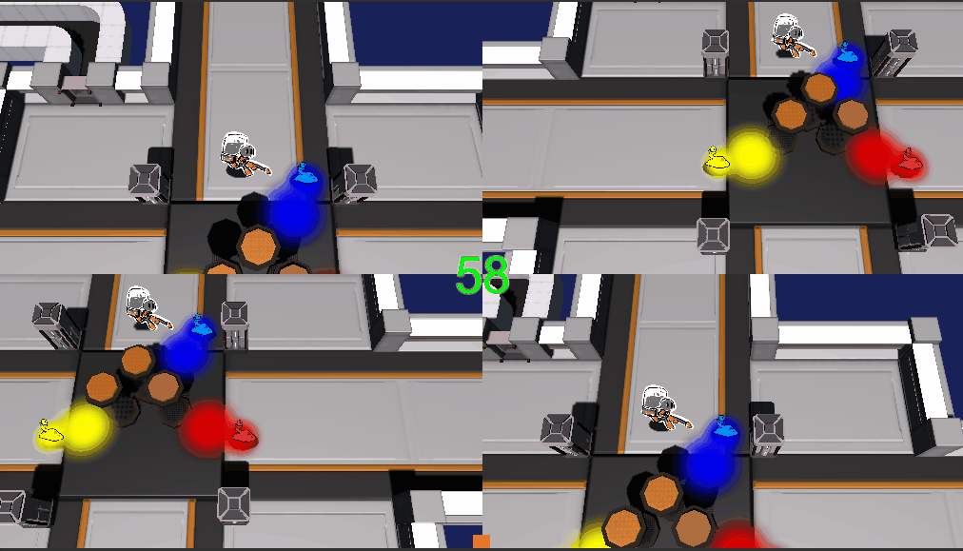
Clean-em-Up!
Demo

Slide 6
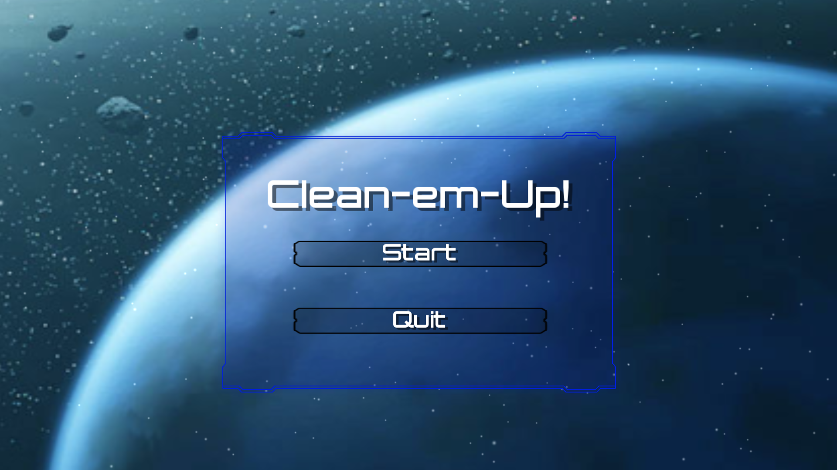
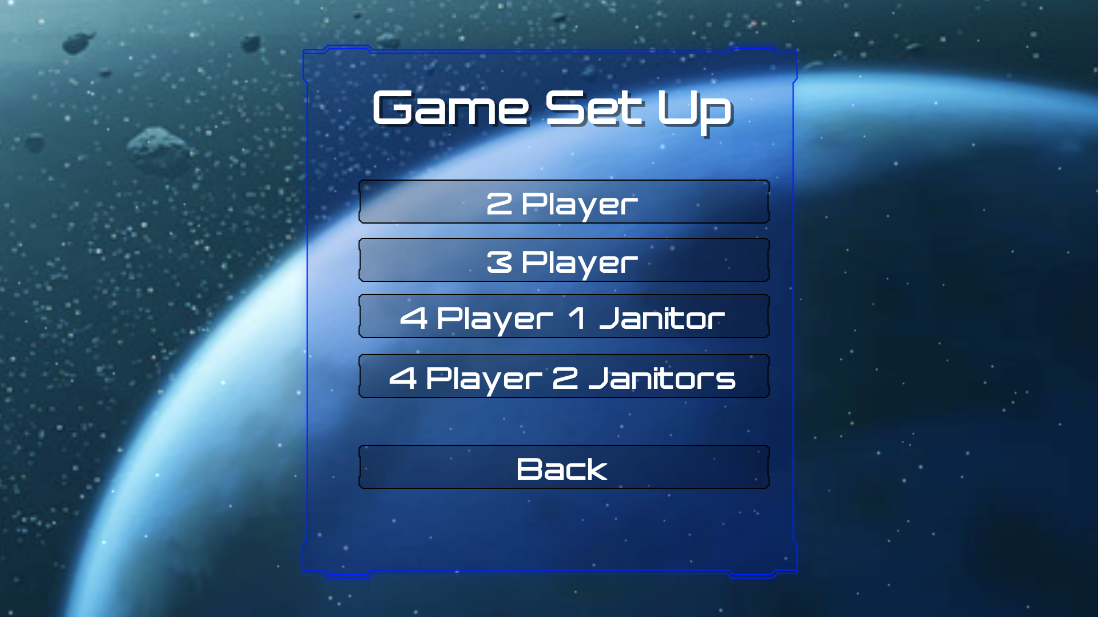
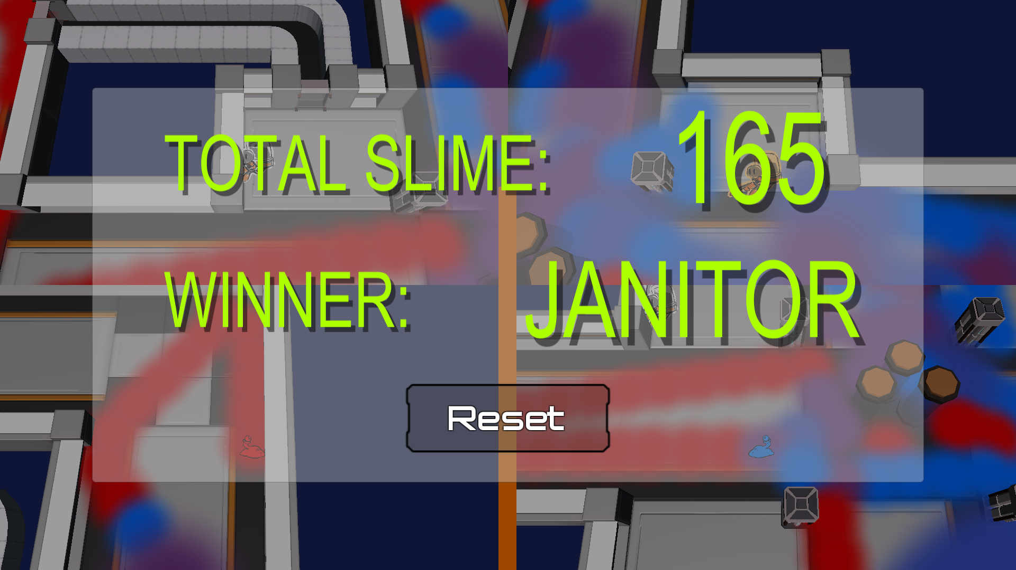
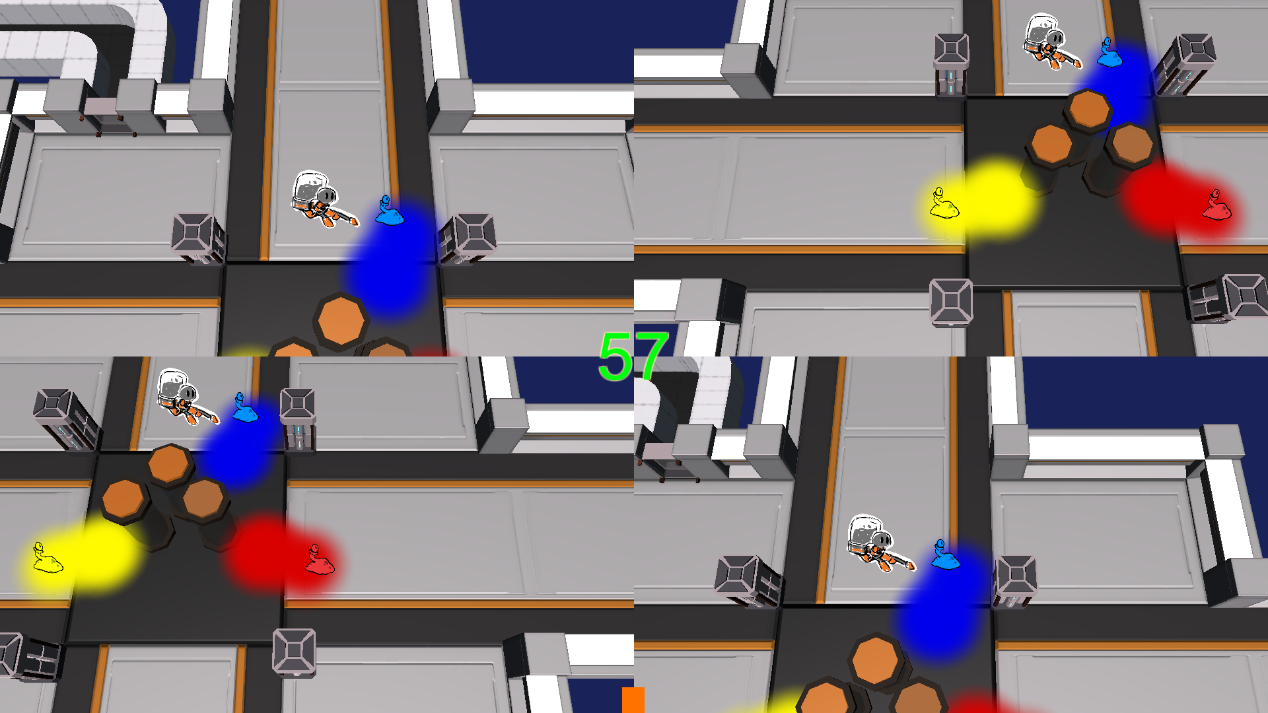
Notes:
Here is some images of the latest version of our game

Slide 7
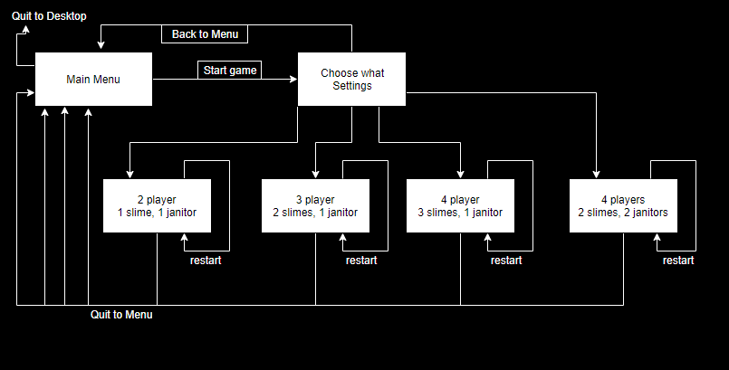
Clean-em-Up!
Diagram
Notes:
A flow diagram of how each scene transition and how each scene is related to one another

Slide 8
Clean-em-Up!
Project Management Techniques
Scrum
Trello was sufficient as a virtual Scrum board
Version Control via GitHub and Unity Collab
Document Sharing via Google Drive
Discord to schedule and communicate

Slide 9
Clean-em-Up!
Enjoyed
Making a game
Attending Scrum meetings
Programing in Unity
Play testing the game
Notes:
Fun to make the game

Slide 10
Clean-em-Up!
Did Not Enjoy
Getting the stuff to merge
Finding and fixing all the weird bugs
Not being able to implement desired features
Sprint reports felt tiring
Lack of time
Notes:
so many merge issues… Had issue with the slimes continuing to lay slime when the game was paused which led to score going mad as well as lagging out. Issues with multiple controllers working at the same time.

Slide 11
Clean-em-Up!
Lessons Learned
What Worked
Scrum meetings
Using agile approach
Unity Collab
Unity engine made creating the game easier
What didn’t Work
Concurrent summer classes
Having 2 repositories to keep up to date
Scheduling a time that everyone could meet at
Wished had been Done
Implement the game more efficiently
Being able include more mechanics

Slide 12



Clean-em-Up!
Technologies
Language: C#
Unity 2018.1.6f1 engine
Photoshop / gimp / Maya

Slide 13
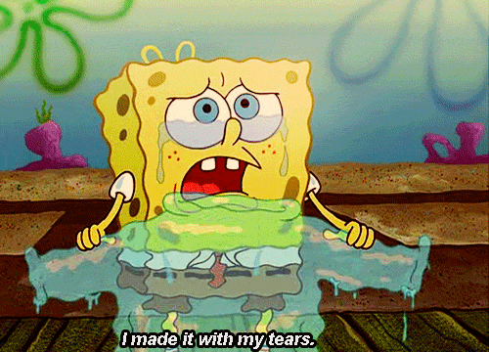
Clean-em-Up!
Q/A

Slide 14
Clean-em-Up!
Q/A

